Slide 1
Chapter 11
NumPy

Slide 2
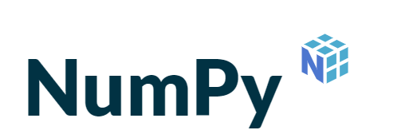

Contents
NumPy
Matplotlib

Slide 3
NumPy
Numeric Python
Open source extension for data science
In data science, we work with matrices. These are collections of related values of the same data type.
Example of study results matrix
Example of blood pressure measurement matrix (upper-lower)
12 | 9 | 11 | 10 | 16 | 8
14,3 | 9,5
13,5 | 8,4
17,5 | 9,7
12,0 | 8,0
Notes:
NumPy is a library for the Python programming language, adding support for large, multi-dimensional arrays and matrices, along with a large collection of high-level mathematical functions to operate on these arrays.
NumPy’s main object is the homogeneous multidimensional array. It is a table of elements (usually numbers), all of the same type, indexed by a tuple of non-negative integers. In NumPy dimensions are called axes.
NumPy’s array class is called ndarray. It is also known by the alias array. Note that numpy.array is not the same as the Standard Python Library class array.array, which only handles one-dimensional arrays and offers less functionality.

Slide 4
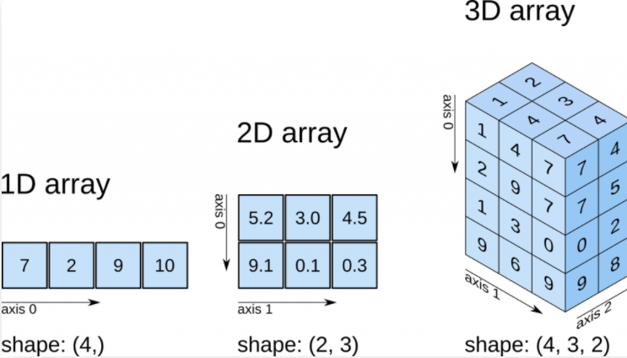
Matrices
Scope of this course:
1 and 2 dimensional arrays

Slide 5
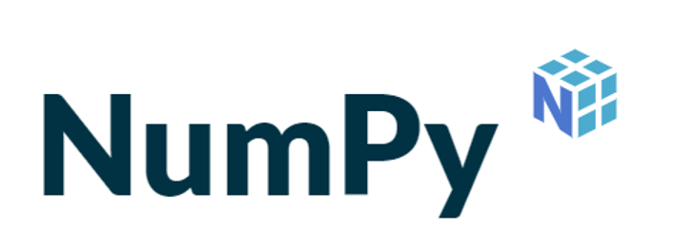
NumPy
To represent such matrices, one could use a Python List.
However, as lists can grow and shrink at any time and as the data type in a list is not fixed, some common actions (min, max, sum, ...) require too much processing time.
Solution to quickly and accurately manage matrices in Python consists of the NumPy array object.

Slide 6
Array
An array is a data structure consisting of a series of values of the same data type, all of which are stored in memory under the same name.
Each value in the series is uniquely addressable by its index number.
In contrast to lists, the number of values stored in an array is fixed,
i.e. the length of the array is fixed.
This length cannot change during the lifetime of the array.
Therefore, no elements can be added to or removed from the array.
However, the value of each element can change.
This is the big difference with a tuple!

Slide 7
So why use arrays?
Arrays can store data very compact and are more efficient for storing large amounts of data
Arrays are great for numerical operations
lists cannot directly handle math operations
for example, you can divide each element of an array by the same number with just one line of code
if you try the same with a list, you'll get an error
To store a relative short sequence of items and you don’t plan to do mathematical operations, use a list
If you have a lot of data and want to do calculations, use an array

Slide 8
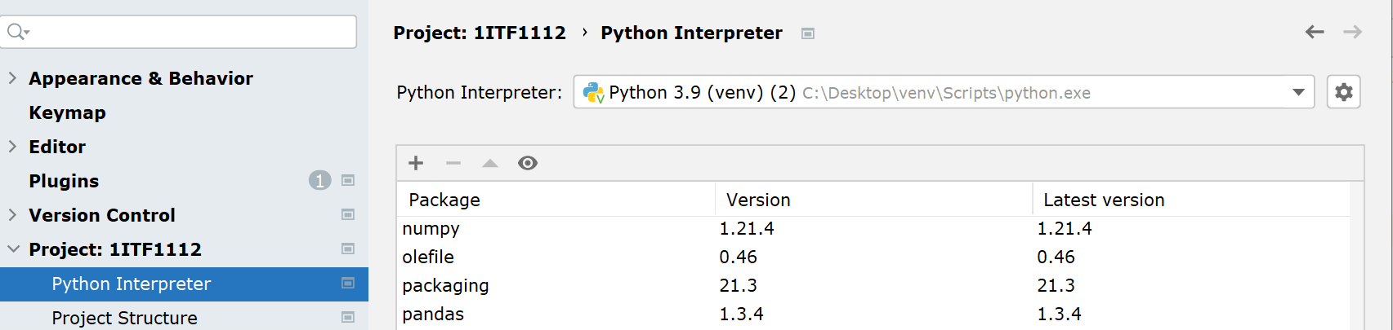
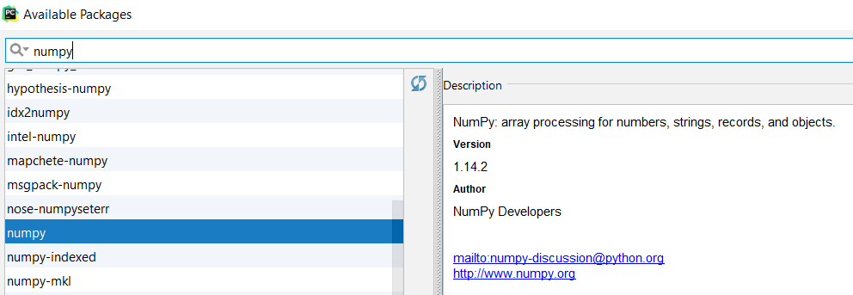

Installing the NumPy package
Settings - Project - Project Interpreter

Slide 9

Create 1-dimensional array
Via the function array() you create an array object.
The first argument is a list or tuple. The number of elements in this list or tuple determines the length of the array.
The second optinal argument specifies the type of the elements.
If this argument is not given, Python determines the type itself.
import numpy as np results=np.array([8,10,12,16,14]) measurements1=np.array((2.3,8.6,7,6.5,2.5,3.4)) measurements2=np.array((2.3,8.6,7,6.5,2.5,3.4), float) print(results) print(measurements1) print(measurements2)

Slide 10
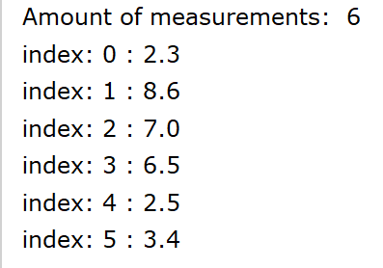
1-dimensional array
Each element can be addressed according to its index position.
The first element has index position 0.
The number of elements of the array can be queried with
the function len() or
the property size.
import numpy as np
measurements = np.array([2.3, 8.6, 7, 6.5, 2.5, 3.4], float)
print('Amount of measurements: ', len(measurements))
for i in range(measurements.size):
print('index:',i,':',measurements[i])

Slide 11
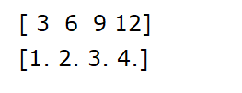

1-dimensional array
calculations are easy with arrays
a list needs a FOR loop to iterate all individual values, do the calculation and write the result back to the list
with an array, you can do these calculation directly
import numpy as np
measurements = np.array((3, 6, 9, 12),int) print(measurements)
division = measurements/3 print(division)
import numpy as np price_without_vat = np.array([100, 78.60, 60.99, 45, 1], float) print(price_without_vat) price_with_vat = np.around(price_without_vat * 1.21, 2) print(price_with_vat)

Slide 12

1-dimensional array append()
Adding elements to an existing array can be done by using append() or insert().
append() works differently than appending to a list.
only new arrays can be appended to an existing array.
the result of these joined arrays needs to be stored in a new array.
import numpy as np
measurements = np.array([2.3, 8.6, 7, 6.5, 2.5, 3.4], float) new_measurements = np.array([5.2, 3.5], float)
combined_array = np.append(measurements, new_measurements)
print(combined_array)

Slide 13
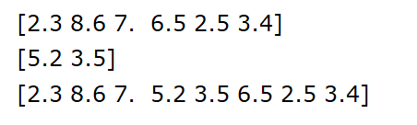
1-dimensional array insert()
insert() gives you the possibility to insert a child array at a specific location in a parent array.
insert() needs 3 parameters:
the parent array that will receive the new data
a location where the new data will be placed
the child array containing the new data
import numpy as np measurements = np.array([2.3, 8.6, 7, 6.5, 2.5, 3.4], float) add_measurements = np.array([5.2, 3.5], float) new_measurements=np.insert(measurements, 3, add_measurements) print(measurements) print(add_measurements) print(new_measurements)

Slide 14
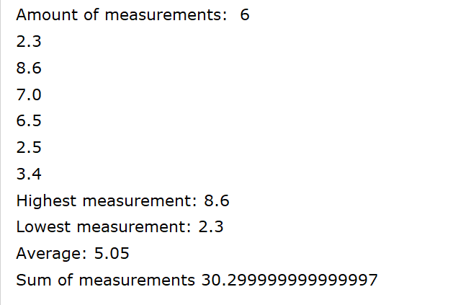
Methods min(), max(), mean(), sum(), ...
By using an array instead of a list, a number of standard operations can be performed
import numpy as np measurements = np.array([2.3, 8.6, 7, 6.5, 2.5, 3.4], float) print('Amount of measurements: ', len(measurements)) for i in range(measurements.size): print(measurements[i]) print('Highest measurement:', measurements.max()) print('Lowest measurement:', measurements.min()) print('Average:', measurements.mean()) print('Sum of measurements', measurements.sum())

Slide 15
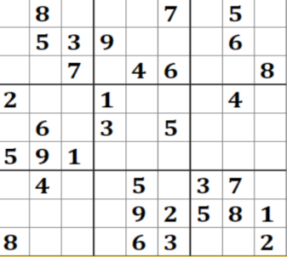

2-dimensional array
A 2-dimensional array is a collection of data of the
same data type in a table with rows and columns.
2-dimensional arrays are very common:
Spreadsheets
Chessboard
Crossword
Sudoku

Slide 16
Create 2-dimensional array
The array contains the grades of 4 students for 3 subjects: Python, Linux and R&S
Each element in the array can now be addressed with a double index position. The number 18 is at index position [2][1]
Python Linux R&S
Dimension/Axes 0
#4 rows students
0
12
9
15
Jef
1
16
11
13
Luca
2
9
18
9
Carmen
3
15
16
12
Anne
Dimension/Axes 1 #3 columns
subjects
0
1
2

Slide 17
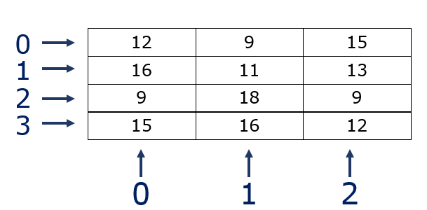
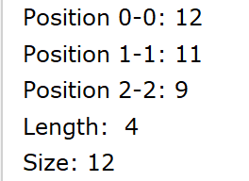
Create 2-dimensional array
Creating 2-d array via array() function
Note that the property ‘size’ returns the total number of elements in the array
len() <> size!
import numpy as np points = np.array([[12, 9, 15], [16, 11, 13], [9, 18, 9], [15, 16, 12]]) print('Position 0-0:',points[0][0]) print('Position 1-1:',points[1][1]) print('Position 2-2:',points[2][2]) print('Length: ',len(points)) print('Size:',points.size)

Slide 18
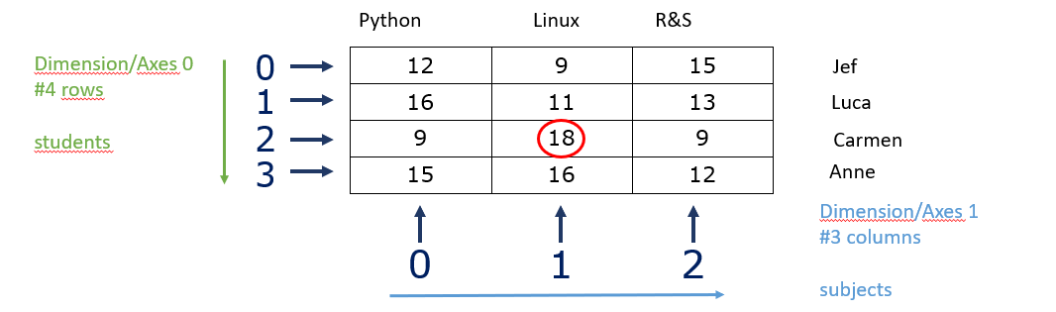
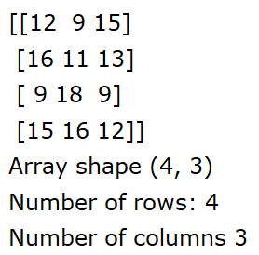
Retrieve number of rows and columns
Via property size
points[0].size --> 3
points[1].size --> 3
Via property shape
returns a tuple with the size for each dimension
import numpy as np points = np.array([[12, 9, 15], [16, 11, 13], [9, 18, 9], [15, 16, 12]]) print(points)
print("Array shape", points.shape) print("Number of rows:",points.shape[0]) print("Number of columns",points.shape[1])

Slide 19
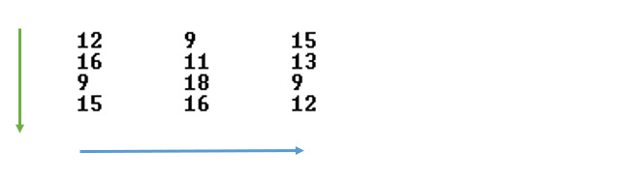
Print items 2-dimensional array
import numpy as np points = np.array([[12, 9, 15], [16, 11, 13], [9, 18, 9], [15, 16, 12]])
for i in range(len(points)): for j in range(points[i].size): print(points[i][j], end="\t") print()
Dimension/Axes 0 (rows): is passed through with the outer for loop i in range(len(points)) i in range(4)
Dimension/Axes 1 (columns): is passed through the inner for loop j in range(len(points[i].size)) j in range(3)

Slide 20
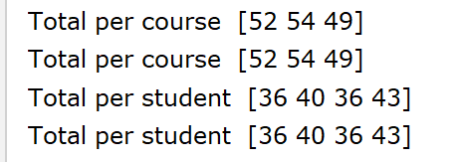
Method sum()
With a 2-dimensional array, you can specify which dimension/axis you want to use as the basis for the method
In other words, you can choose whether to calculate the sum per column (axis 1) or per row (axis 0)
import numpy as np points = np.array([[12, 9, 15], [16, 11, 13], [9, 18, 9], [15, 16, 12]]) print("Total per course ", points.sum(0)) print("Total per course ",np.sum(points, axis=0)) print("Total per student ", points.sum(1)) print("Total per student ",np.sum(points, axis=1))

Slide 21
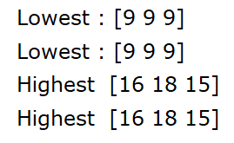
Methods amin(), min(), amax(), max()
Search for the highest or lowest values in a row or column.
The numpy functions amin() and amax() require 2 parameters, a 2 dimensional array and an dimension/axis.
import numpy as np points = np.array([[12, 9, 15], [16, 11, 13], [9, 18, 9], [15, 16, 12]]) print('Lowest :', np.amin(points, axis=0)) print( 'Lowest :',np.min(points, axis=0))
print('Highest ', np.amax(points, axis=0)) print( 'Highest ',np.max(points, axis=0))
amax() and max() call the same function

Slide 22
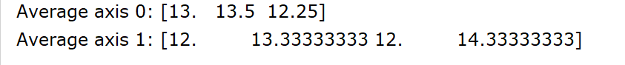
Method mean()
To calculate the average
import numpy as np points = np.array([[12, 9, 15], [16, 11, 13], [9, 18, 9], [15, 16, 12]]) print('Average axis 0:', np.mean(points, axis=0)) print('Average axis 1:', np.mean(points, axis=1))
Notes:
np.set_printoptions(precision=0)
To avoid blancs

Slide 23




Slicing 2d array
We would like to grasp the grades of Luca for Linux en R&S -> via slicing!
import numpy as np points = np.array([[12, 9, 15], [16, 11, 13], [9, 18, 9], [15, 16, 12]])
print(points[0,:])
print(points[:,0])
print(points[:,1])
print(points[0:2,:])
[0th dimension, 1st dimension]
[start:stop, start:stop] ->stop not included

Slide 24

Clean data
Within the scope of this course, we only read from clean files!
Cleaning data will be discussed in the course Data Visualisation (2nd year)
Only a brief introduction to data visualisation is given within this course!

Slide 25
Loading data into an array from a file
To load data in an array using text files, numpy has several built in functions:
without missing values: numpy.loadtxt(fname, delimiter, …) more info: https://numpy.org/doc/stable/reference/generated/numpy.loadtxt.html
with missing values: numpy.genfromtxt(fname, delimiter, filling_values,…) more info: https://numpy.org/doc/stable/reference/generated/numpy.genfromtxt.html#

Slide 26
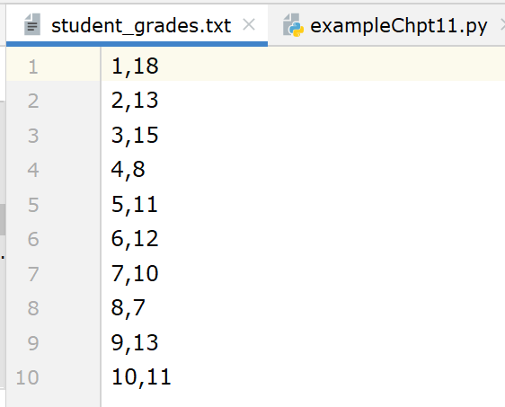
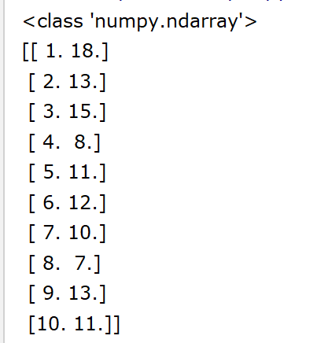
Loading data into an array via loadtxt()
import numpy as np loaded_data = np.loadtxt(fname='student_grades.txt', delimiter=',')
print(type(loaded_data)) print(loaded_data)
loadtxt(): load data from a text file.
Each row in the text file must have the same number of values.
Data-type of the resulting array; default: float
dtype= int()

Slide 27
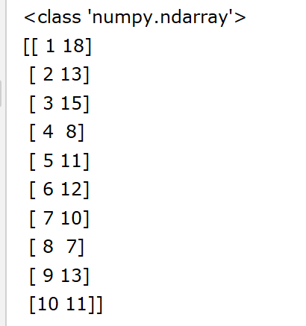
Loading data into an array via loadtxt()
import numpy as np loaded_data = np.loadtxt(fname='student_grades.txt', delimiter=',',dtype=int)
print(type(loaded_data)) print(loaded_data)
Data-type of the resulting array; default: float
dtype= int()

Slide 28
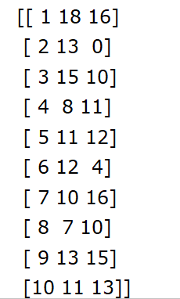
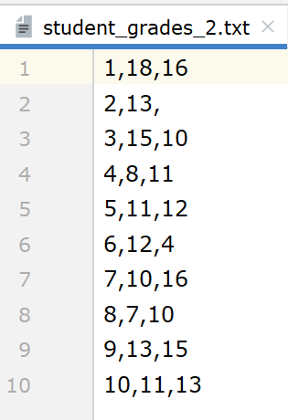
Loading data into an array via genfromtxt()
import numpy as np loaded_data = np.genfromtxt(fname='student_grades_2.txt', delimiter=',', dtype=int, filling_values='0') print(loaded_data)
genfromtxt(): load data from a text file, with missing values handled as specified.

Slide 29
MatPlotLib
Matplotlib is a Python library used for plotting beautiful and attractive Graphs.
In data crunching, visualization is an important step. By using visualization we can easily understand how data is split and predictions are made.
We will use PyPlot for the configuration of our graphs.
Matplotlib.pyplot is a collection of command style functions.
Each PyPlot function makes some changes to a figure: e.g., creates a figure, creates a plotting area in a figure, plots some lines in a plotting area, decorates the plot with labels, etc.

Slide 30
Essential Elements of Good Graphs
A title which describes the graph
The graph should fill the space allotted for the graph
Each axis should be labeled with the quantity being measured and the units of measurement
Each data point should be plotted in the proper position
A line of best fit

Slide 31
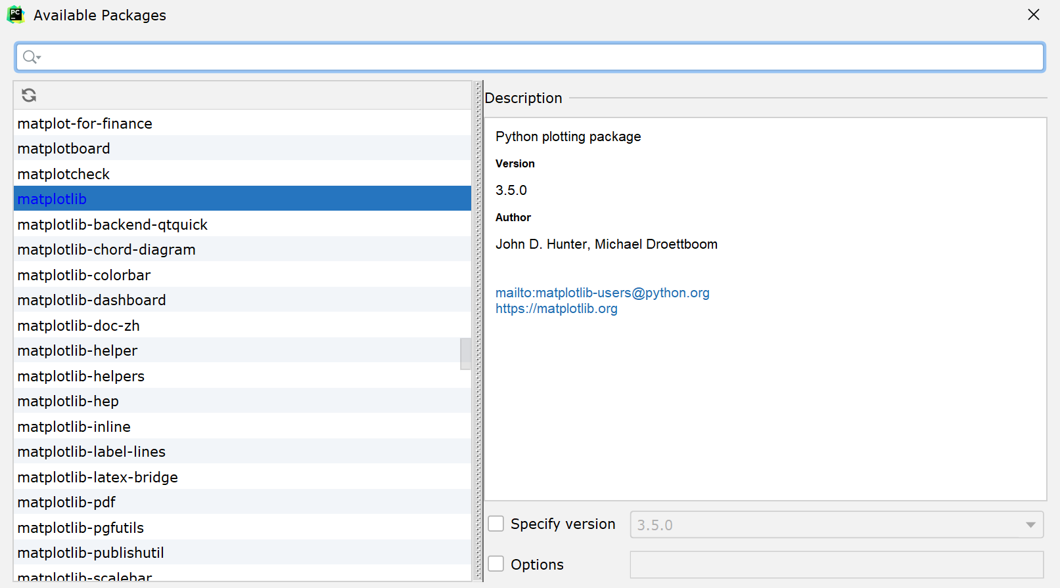
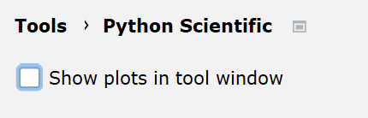
Installing MatPlotLib
Data in arrays can also be visualised or plotted.
In PyCharm Professional 2017.3 open File | Settings | Tools | Python Scientific.
Turn off the "Show plots in tool window" option.

Slide 32
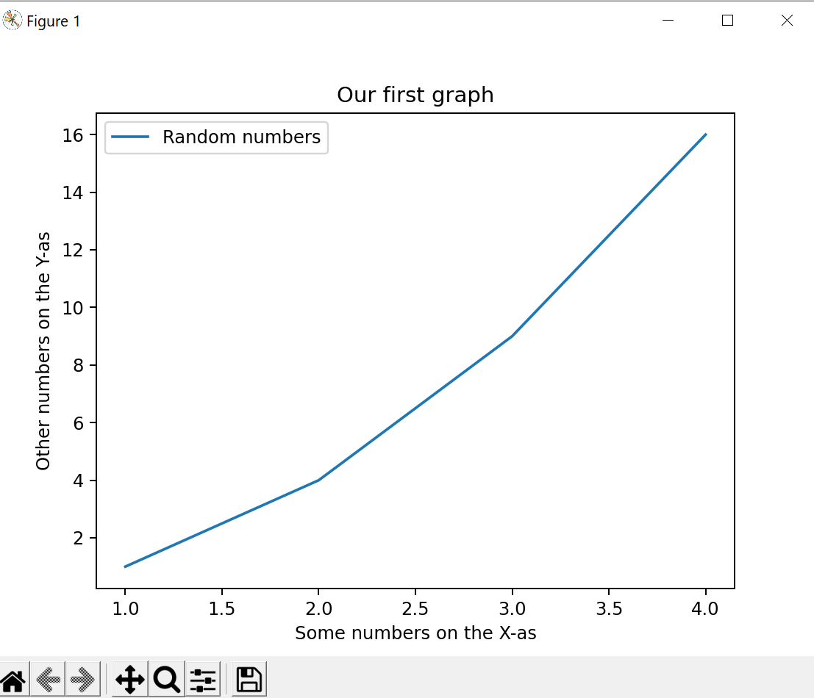
MatPlotLib with PyPlot: example 1
Creating a simple line graph based on 2 arrays via plot()
import numpy as np from matplotlib import pyplot as plt array_one = np.array([1, 2, 3, 4]) array_two = np.array([1, 4, 9, 16]) #create line graph plt.plot(array_one, array_two, label='Random numbers') plt.title('Our first graph') plt.xlabel('Some numbers on the X-as') plt.ylabel('Other numbers on the Y-as') plt.legend() #show the legend plt.show() #draw the graph

Slide 33
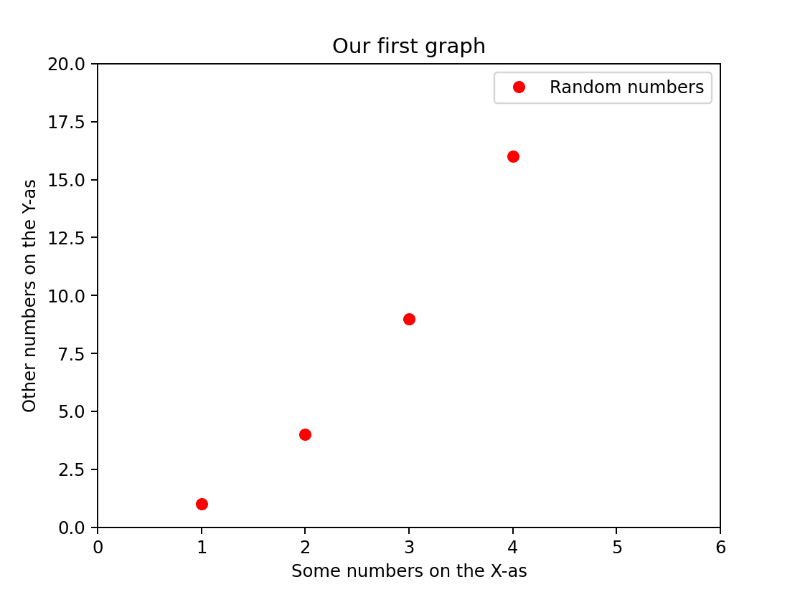
MatPlotLib with PyPlot: formatting
There is an optional third argument which is the format string that indicates the color and line type of the plot.
Plot red (r) circles (o).
The axis() command takes a list of [xmin, xmax, ymin, ymax] and specifies the viewport of the axes.
import numpy as np from matplotlib import pyplot as plt array_one = np.array([1, 2, 3, 4]) array_two = np.array([1, 4, 9, 16]) #create line graph plt.plot(array_one, array_two, 'ro', label='Random numbers') plt.title('Our first graph') plt.xlabel('Some numbers on the X-as') plt.ylabel('Other numbers on the Y-as') plt.axis([0, 6, 0, 20]) plt.legend() #show the legend plt.show() #draw the graph

Slide 34
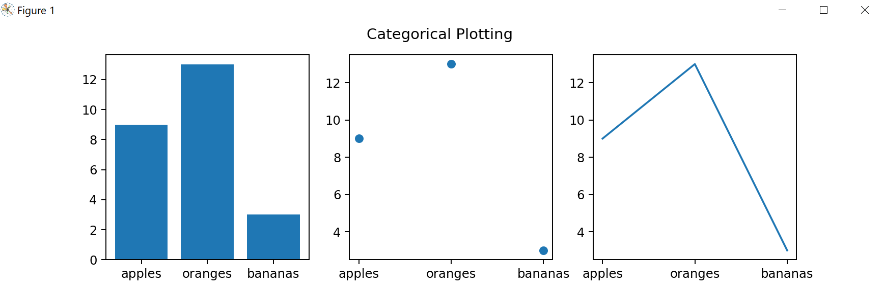
MatPlotLib with PyPlot
Create a plot using categorical variables.
These are variables with a fixed number of possible values.
import matplotlib.pyplot as plt names = ['apples', 'oranges', 'bananas'] values = [9, 13, 3] plt.figure(figsize=(10, 3)) # width = 10, height = 3 plt.subplot(131) # 1 row, 3 columns, put this subplot in the first column plt.bar(names, values) plt.subplot(132) # 1 row, 3 columns, put this subplot in the second column plt.scatter(names, values) plt.subplot(133) # 1 row, 3 columns, put this subplot in the third column plt.plot(names, values) plt.suptitle('Categorical Plotting') plt.show()

